Slide 1

AXA Secure GPT Deployment

Slide 2
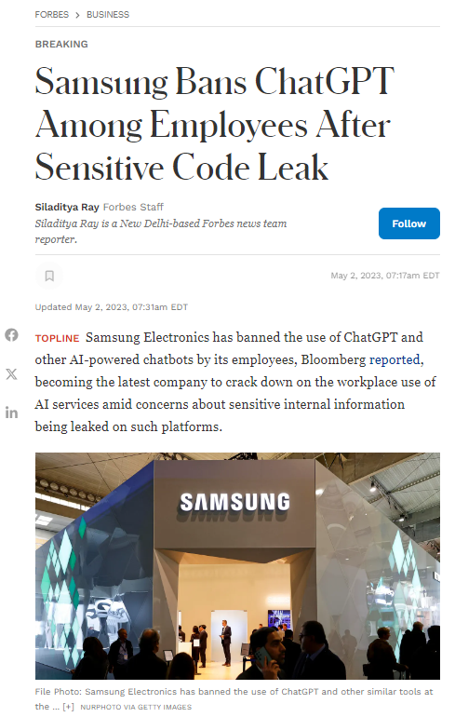
AXA faces a strategic need to integrate generative AI technologies while ensuring maximum security and strict compliance with regulatory frameworks
Risk
Data-privacy compliant environment
AXA aims to protect sensitive customer data while leveraging the benefits of generative AI across its global workforce of 140,000 employees
Reputational Damage and Loss of Trust
Inaccurate or biased responses, especially in critical functions like claims management or underwriting could erode customer trust
Data Breaches and Privacy Violations
Misuse of ChatGPT can lead to breaches of sensitive customer data, which could result in heavy financial penalties

Slide 3



The challenges of implementing Generative AI in a highly regulated environment
A secured data journey
Ensure Compliance with AXA Security comities
Build Awareness on Generative AI
While leveraging a secure tenant on Azure, the isolation needed to maintain data confidentiality limits flexibility. This isolation introduces complexities in scaling the integration with broader AI applications
For AXA Secure GPT to be fully implemented, the solution must pass through all security committees within AXA. This rigorous approval process ensures that the system complies with the company’s stringent data protection and cybersecurity protocols​
Drive engagement and understanding of Generative AI across global teams
Notes:
Sources:
https://masterofcode.com/blog/chatgpt-statistics
AI and ChatGPT can help insurers improve the claims experience (lifeinsuranceinternational.com)

Slide 4
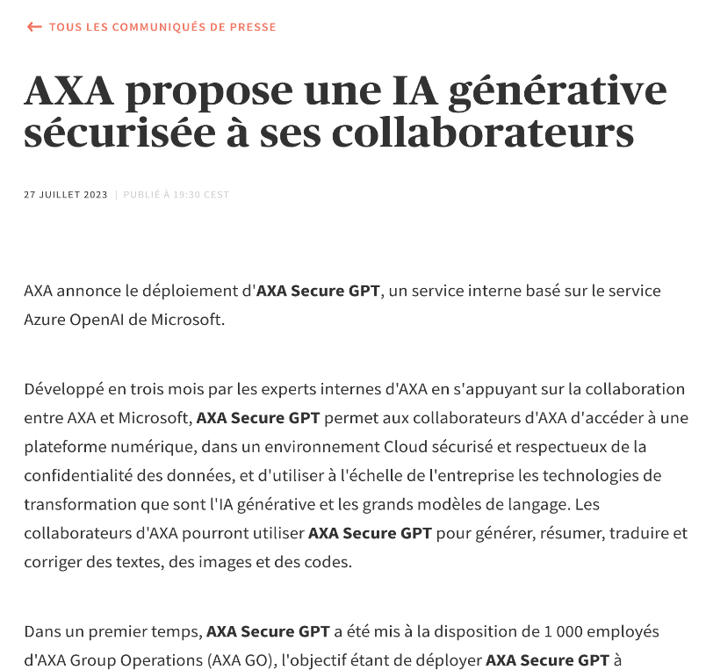


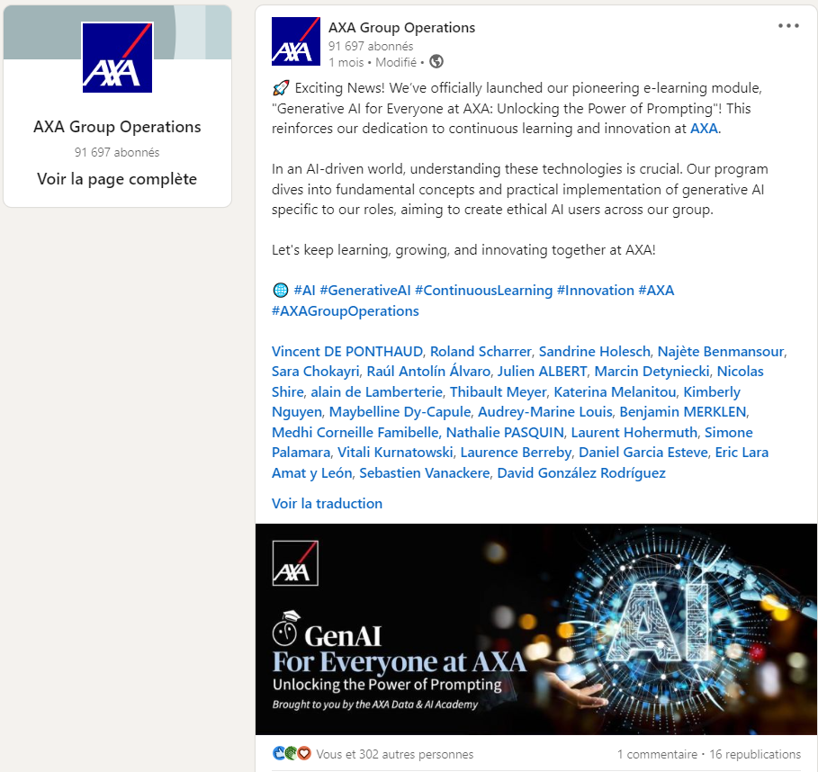
AXA Secure GPT enhances AI deployment with a focus on security
86%
Achieved 86% adoption among AXA HQ employees
Launched the Generative AI for Everyone at AXA e-learning module
Leveraged Azure OpenAI to implement a scalable, secure, and compliant infrastructure for AI use across the organization
35K
Assisting 35 000 employees (expanding to 100 000.) across various functions, enhancing efficiency, document drafting, underwriting, etc.

Slide 5





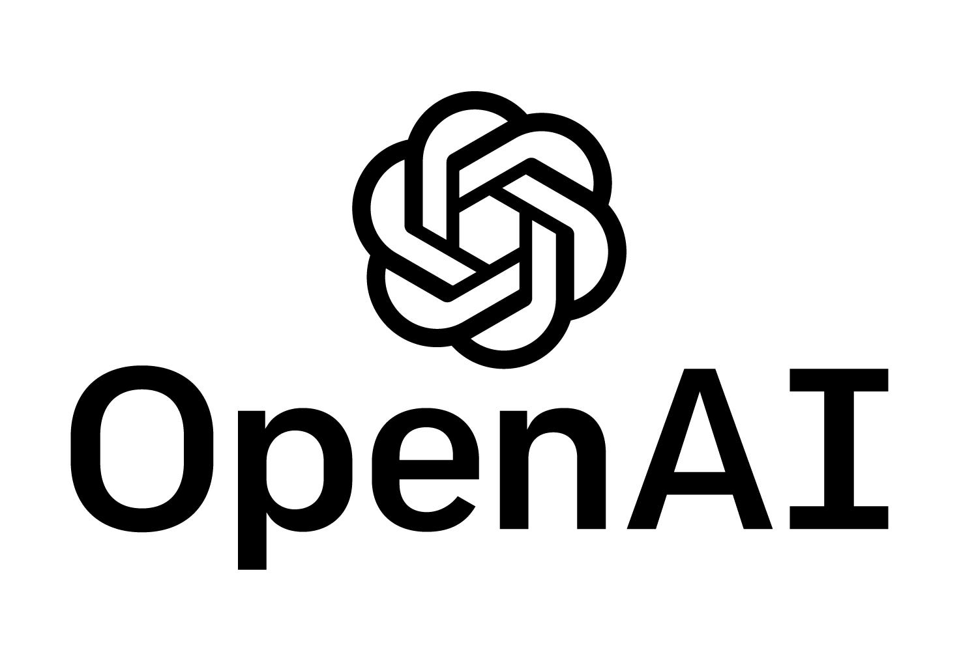

Secure GPT & Generative AI
2x Senior Data Scientist (10 months)
GPT Azure DevOps LangChain Azure Data Lake SharePoint Framework Python

